Slide 1
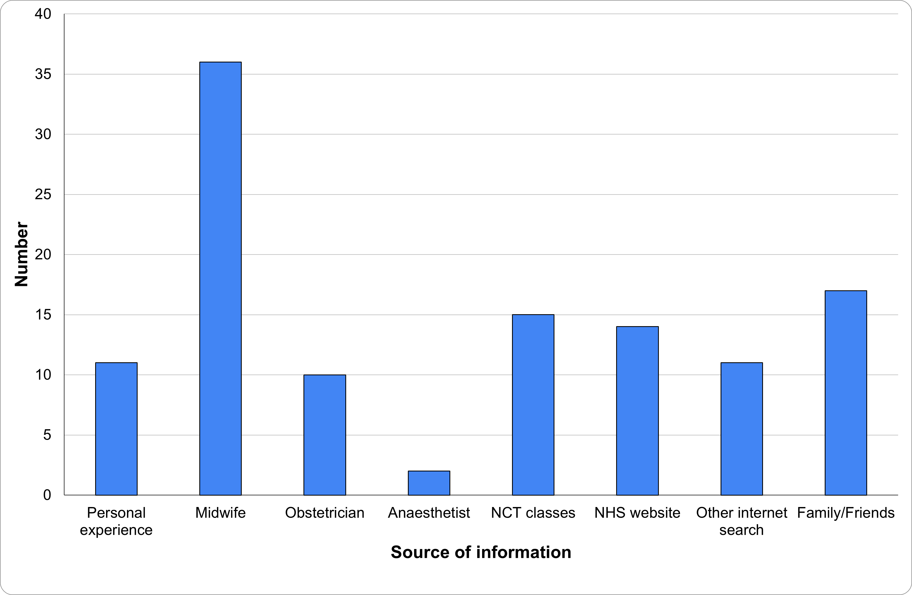
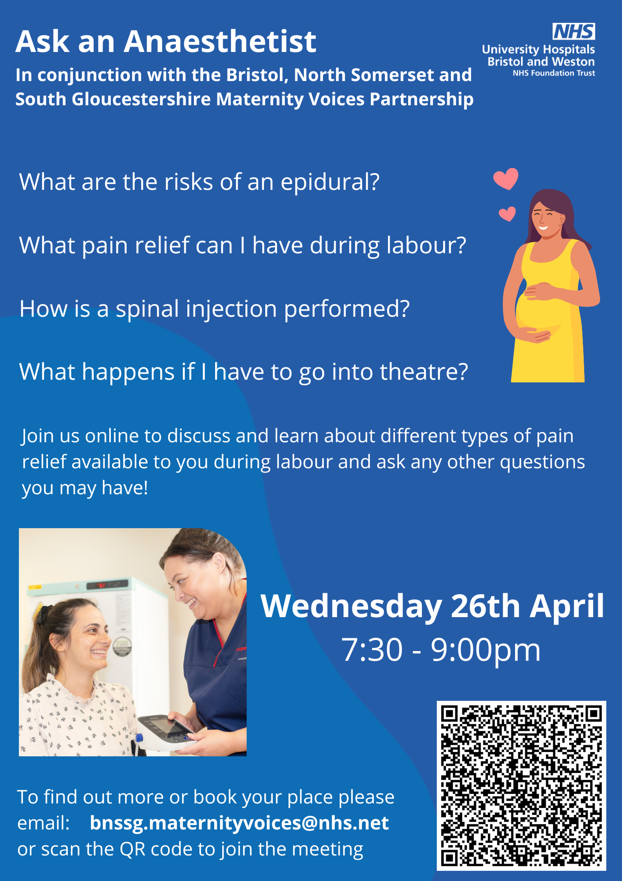
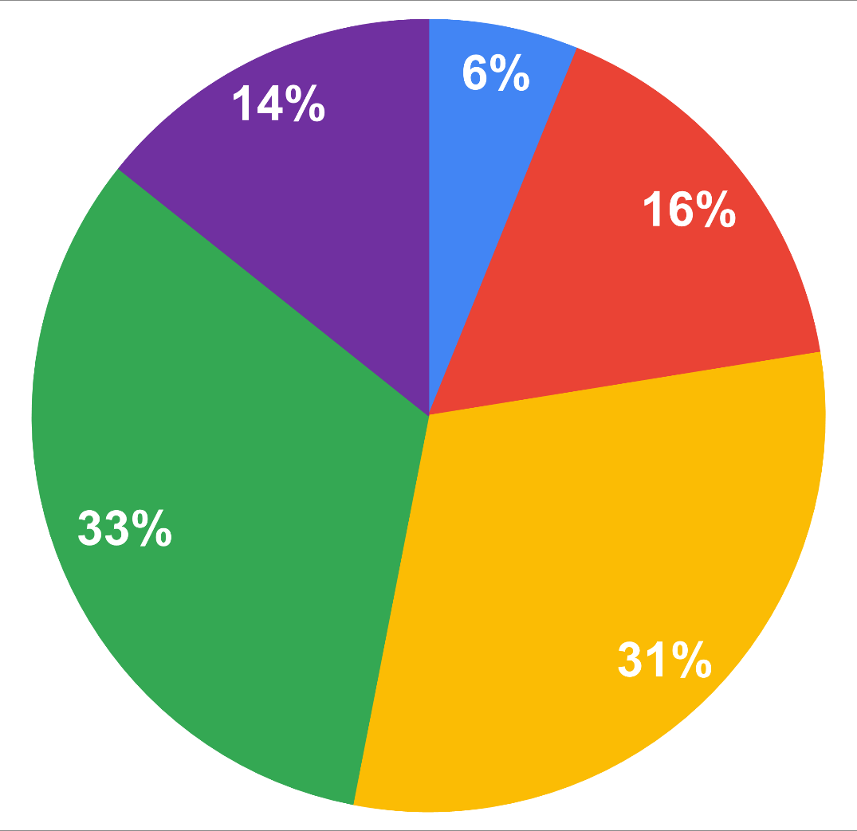
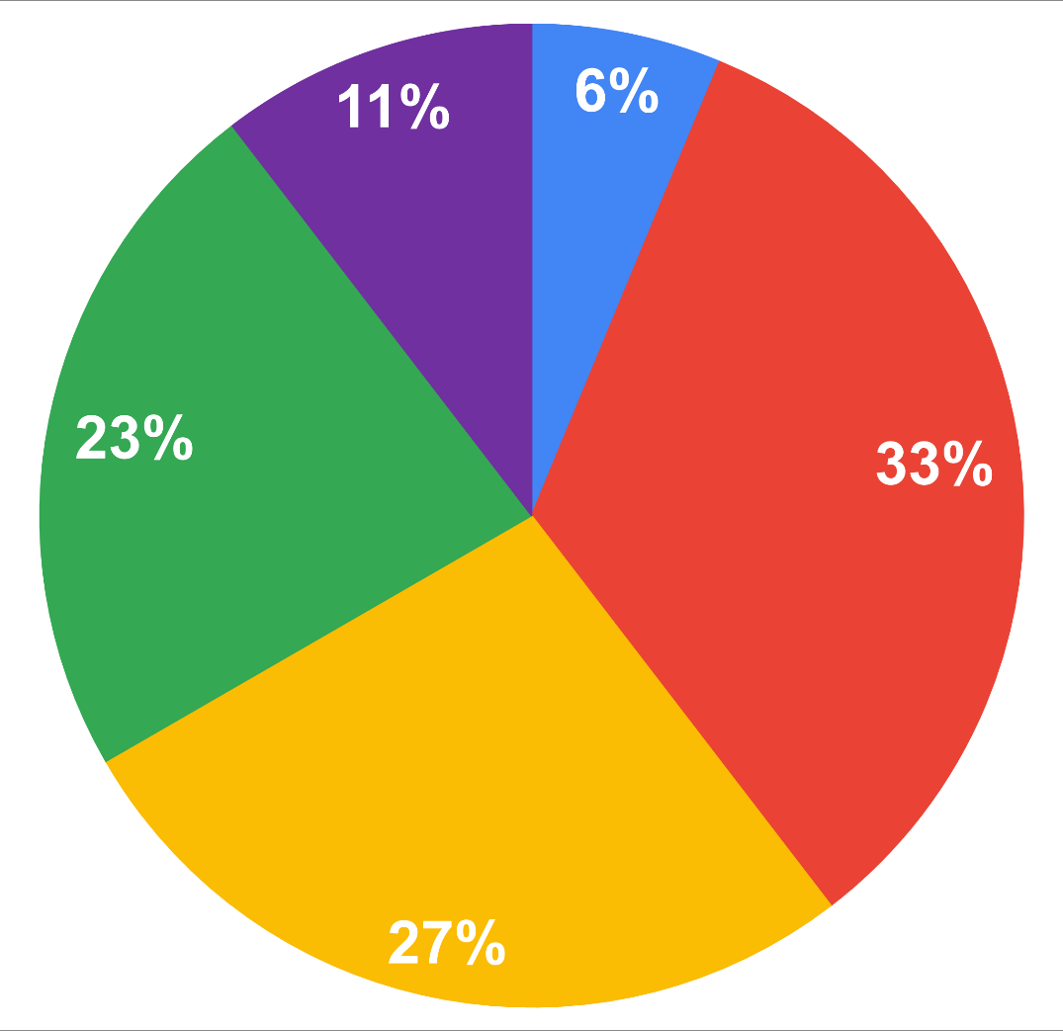
Ask an Anaesthetist: Informing parents about pain relief options in labour
W Gatfield, F Los, R Powell, B Gupta
Anaesthetic Department, St Michael’s Hospital, University Hospitals Bristol and Weston NHS Foundation Trust
INTRODUCTION
RESULTS
ASK AN ANAESTHETIST
CONCLUSIONS
Approximately 60% of women require anaesthetic intervention around the time of delivery of their baby¹
NICE and RCoA both recommend that women should have access to information about pain relief and anaesthesia during labour and delivery^{2,3}
Frequently, the first time a mother meets an anaesthetist is during labour, when taking on new information and making informed decisions can be overwhelming
49 responses: 67% primiparous
49% in favour of attending a group meeting to discuss pain relief during labour
63% in favour of an online meeting
Based on the survey responses we set up ‘Ask an Anaesthetist’ - a regular virtual meeting designed to enable parents to learn about the analgesic options in labour
Session covered non- pharmacological, pharmacological and regional options, including the risks and benefits
Q&A feature at the end of the session
Advertised and delivered in collaboration with Health Matters, the UHBW trust programme for public information and engagement, and the Maternity Voices Partnership, an NHS working group that works to develop local maternity care
There is an appetite for further specialist advice antenatally about analgesic options during labour
An online session delivered by anaesthetists enables information to be given to expectant parents in an evidence-based and non-biased fashion
Collaboration with Health Matters and the local Maternity Voices Partnership group has enabled adequate reach to the target audience and ensures expectant mothers’ voices are heard
We plan to continue the delivery of these sessions to parents in the local area every three months, developing the session as necessary based on feedback received
Graph 1: Where did parents find out information about pain relief or anaesthetic options in labour
The aim of this project was to elicit if there is a desire for further antenatal advice about analgesic options during labour and to design a meeting to achieve this
Figure 1: Example advertisement for one of the ‘Ask an Anaesthetist’ sessions
METHODS
Graph 2: Survey result – “I wish I had known more about my pain relief options during labour”
Survey of post-natal mothers who had anaesthetic intervention during labour
Questions aimed to identify where they had received information about pain relief antenatally and whether they wished they had known more about the analgesic options available
Survey could be completed in 2 minutes
QR code to complete survey was provided to mothers during routine post-natal anaesthetic review
ACKNOWLEDGEMENTS
Thank you to the Health Matters team and the Maternity Voices Partnership for their help in advertising and delivering the ‘Ask an Anaesthetist’ sessions
FEEDBACK
Graph 3: Survey result – “I wish I had known more about the different types of anaesthetic I might need during childbirth”
100% of attendants found the meeting useful and liked the online format
REFERENCES
¹ NHS Digital. NHS Maternity Statistics – England 2021-22
² National Institute for Health and Clinical Excellence. Antenatal Care. Clinical Guideline NG201, 2021
³ Royal College of Anaesthetists. Guidelines for the Provision of Anaesthetic Services for an Obstetric Population (Chapter 9), 2023
“Got answers I’ve been trying to get for years”
“Really helpful, the structure was great and good length”

